Slide 1
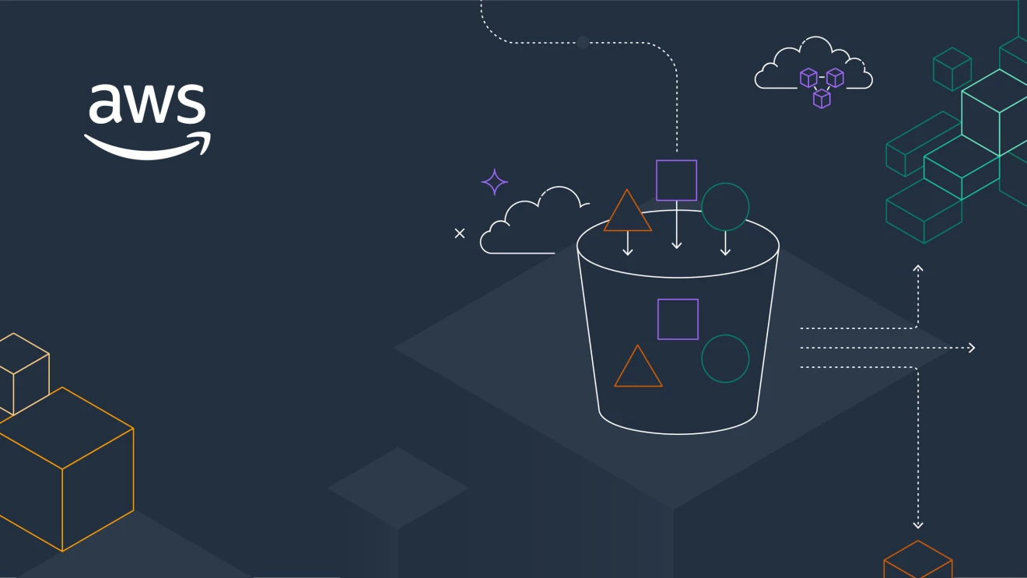

AWS Elastic Beanstalk
SATMARI IULIUS-GABRIEL-MARIAN 244

Slide 2

AWS Elastic Beanstalk
AWS offers over 200 services Each of these offers a different functionality The variety of these services offers great flexibility Providing and choosing these services can become difficult

Slide 3
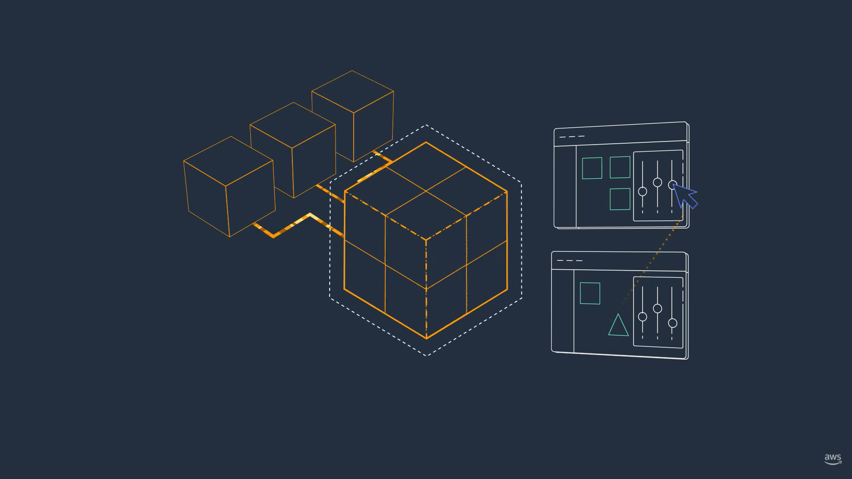
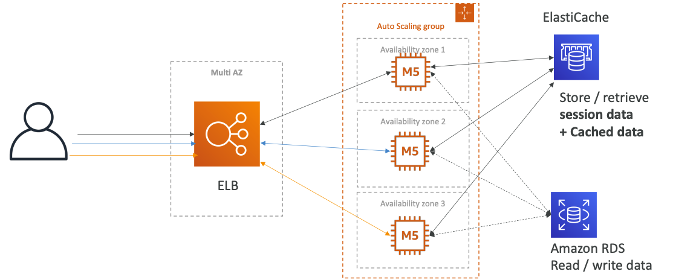
AWS Elastic Beanstalk
When we deploy to a web application on AWS, we usually use a 3-tier architecture Users communicate with a load balancer (ELB) (can be multi AZ) ELB forwards traffic to several EC2 instances administered by ASG EC2 instances can be used by Amazon RDS or ElastiCache

Slide 4

AWS Elastic Beanstalk
AWS Elastic Beanstalk is used to create such an architecture It is centered on the point of view of the programmer From a cloud perspective it's Platform as a Service (PaaS) There is no need to manage the infrastructure, only the code itself

Slide 5

AWS Elastic Beanstalk
Elastic Beanstalk is a free service and you only pay for the underlying services Full access to the entire configuration It mainly deals with: Instance Configuration / OS Deployment strategy Set up your storage medium Load balancing & auto-scaling Application monitoring

Slide 6
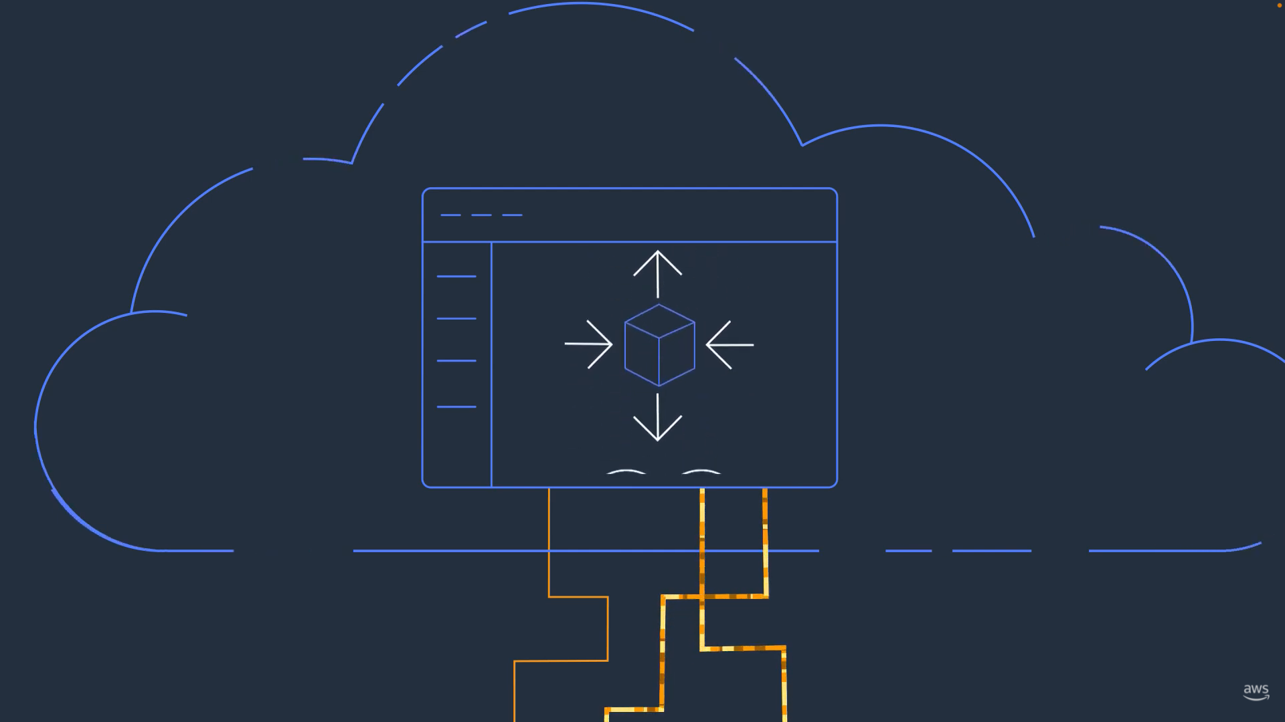
AWS Elastic Beanstalk
3 architectural models: Single Instance deployment (development) LB+ASG (for production or pre-production) ASG only (for non-web applications in production, e.g. workers) Multiple platforms available: Go, Java SE/Tomcat, .NET, Node.js, PHP, Python, Ruby, Packer Builder, Single-Container Docker, Multi-Container Docker, Preconfigured Docker

Slide 7
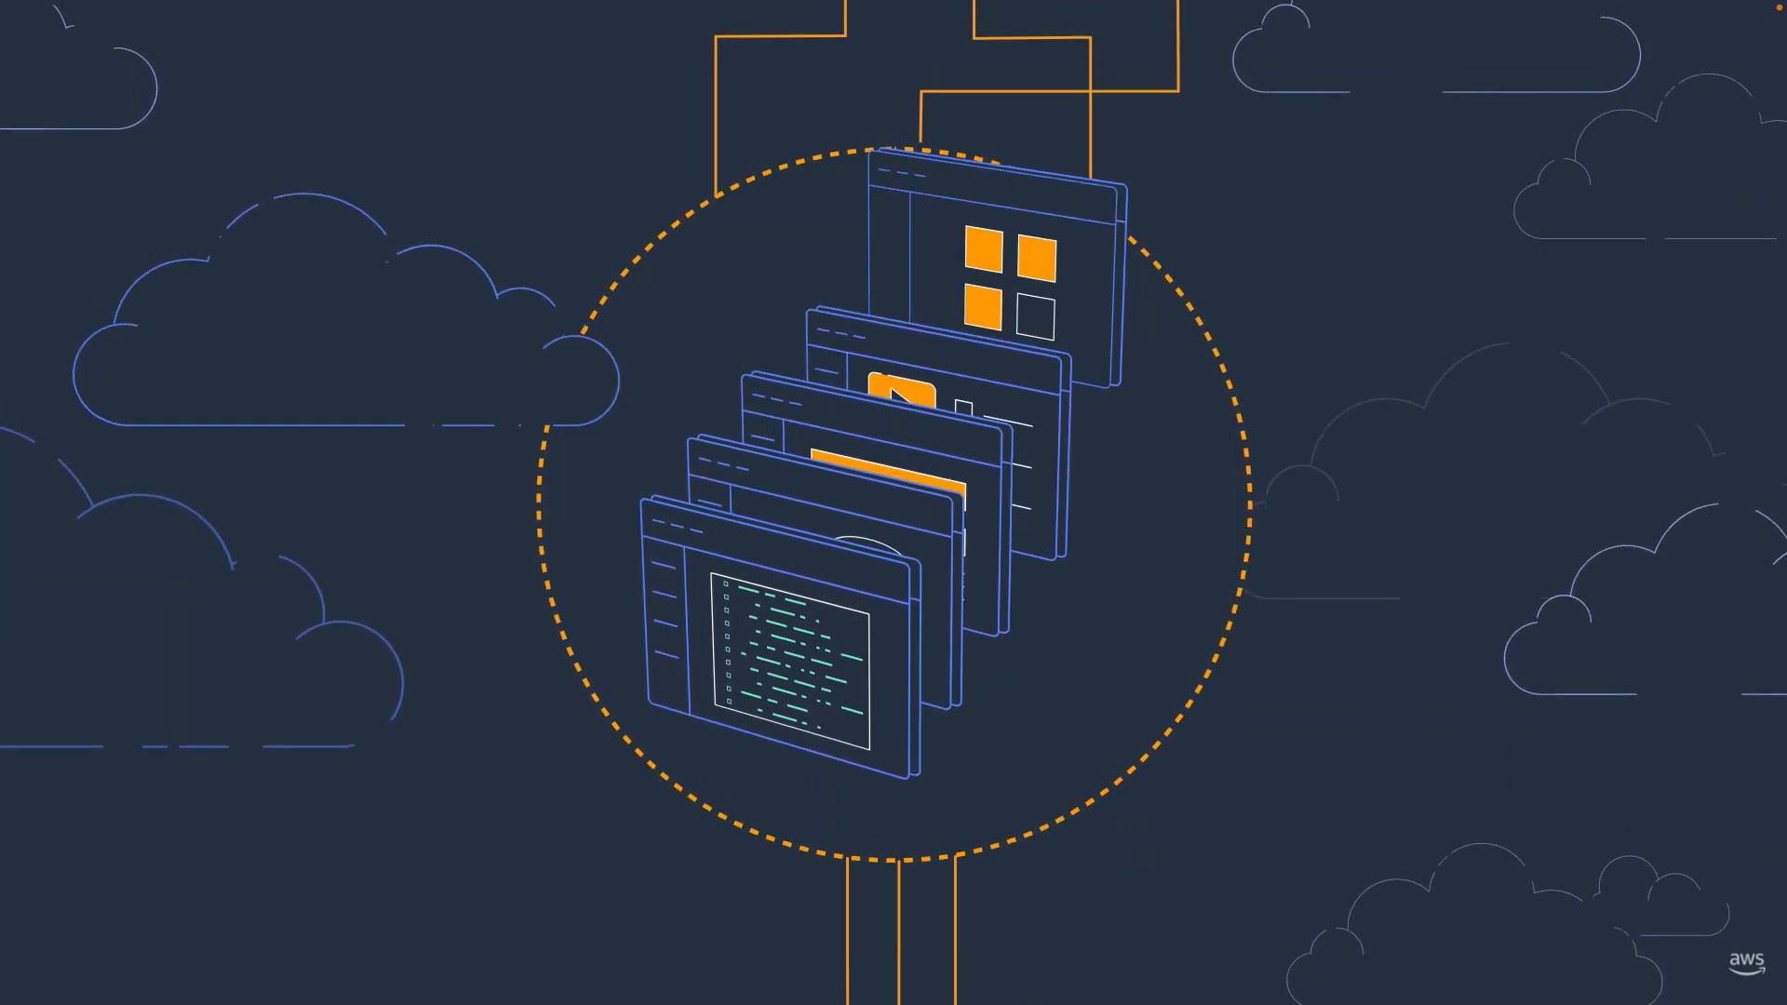
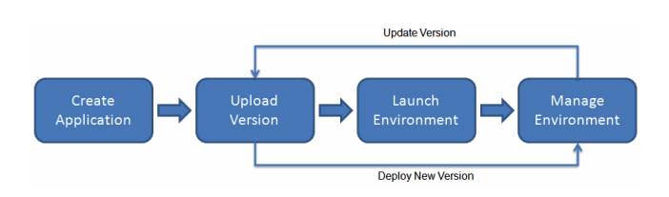
AWS Elastic Beanstalk
Elastic Beanstalk can be used from elastic Beanstalk consoles, AWS CLI or eb (cli high level developed especially for Beanstalk) To deploy an application you just have to upload the application bundle (ex: java .war file)

